Slide 1
Rohit Sharma: The 'Hitman' of Indian Cricket
A Presentation on Rohit Sharma- Indian Cricketer

Slide 2
Overview: Unveiling Rohit Sharma
Explore the journey of Rohit Gurunath Sharma, a celebrated Indian international cricketer.
Understand his pivotal role as the current captain of India's ODI national team.
Discover his distinctive batting style, characterized by elegance, timing, and powerful hitting.
Highlight his significant achievements, records, and leadership qualities on and off the field.
Recognize his immense popularity and influence within the global cricketing community.

Slide 3
A Pillar of Indian Cricket: Role & Leadership
Rohit Gurunath Sharma, born on 30 April 1987, is a prominent figure in Indian international cricket.
He currently holds the crucial position of captain for the India national team in One Day Internationals (ODIs).
Sharma has also previously served as captain for India in both Test matches and T20 Internationals.
His emergence from the Mumbai suburbs marked him as an heir apparent to India's rich batting legacy.

Slide 4
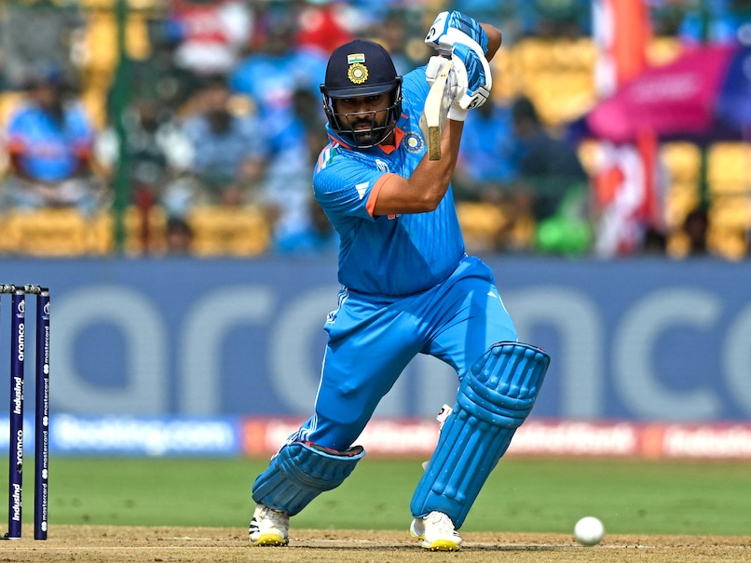
The 'Hitman': Batting Elegance and Power
Rohit Sharma is widely recognized for his elegant and flamboyant batting style.
He possesses exceptional timing and a languid, easy-on-the-eye approach at the crease.
Popularly known as the 'Hitman', he has endeared the cricket world with his big-hitting prowess.
His ability to consistently destroy even the best bowling attacks is a hallmark of his game.
Sharma is noted for owning all the shots in the book, showcasing a complete repertoire of batting skills.

Slide 5
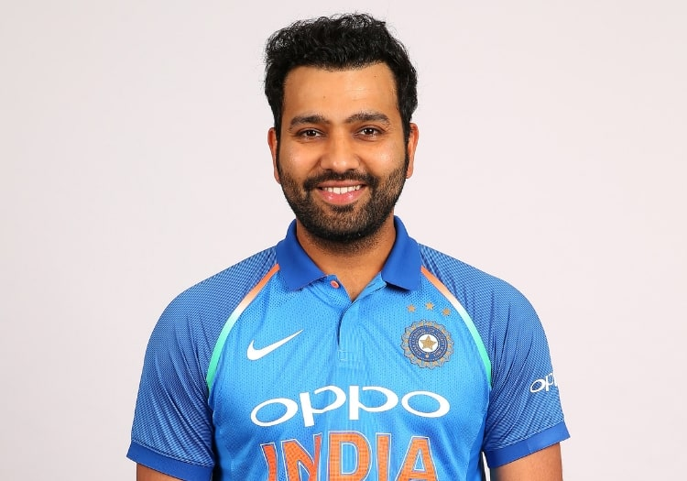
Record-Breaker and Premier Batter
Rohit Sharma is a prolific record-breaker, having achieved numerous milestones in international cricket.
He stands as one of India's premier batters, consistently delivering impactful performances at the highest level.
His extensive profile, including detailed stats, rankings, and records, is widely featured on platforms like ESPNcricinfo.
Sharma's unique blend of elegance, timing, and big-hitting solidifies his status as a top-tier global player.

Slide 6
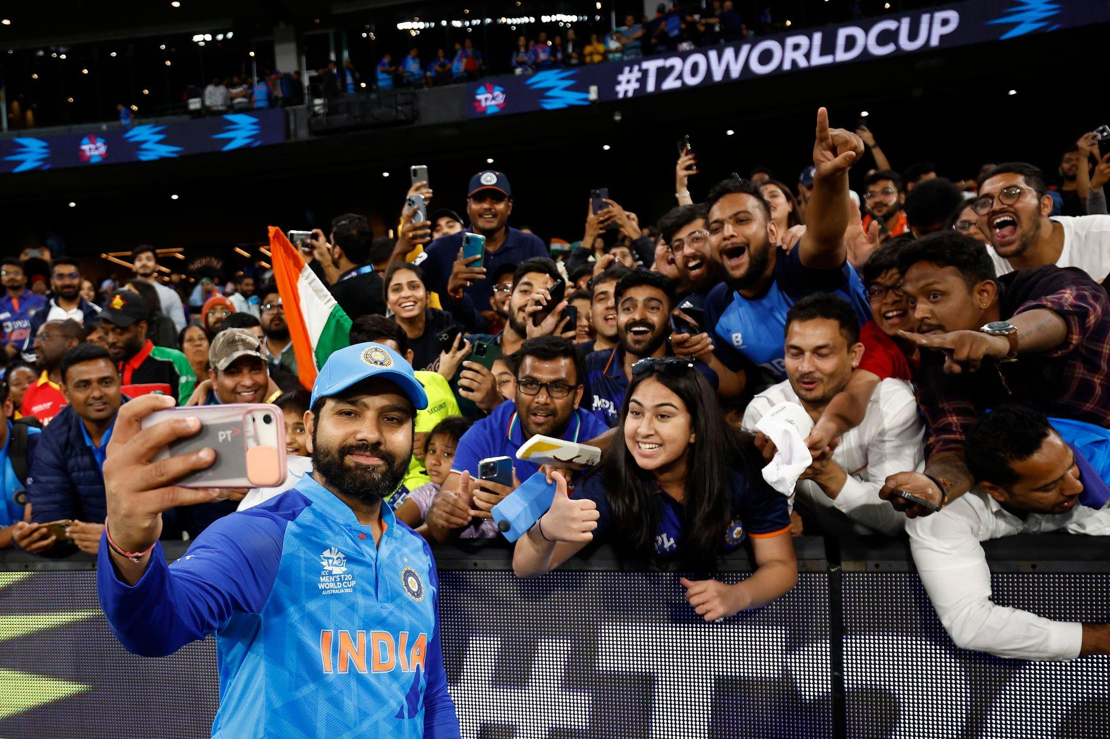
Influence and Global Recognition
Beyond his playing prowess, Rohit Sharma is widely regarded as one of the finest captains in world cricket.
His leadership has been instrumental in guiding the Indian national team across various formats and challenges.
Sharma commands a significant global presence, evidenced by his massive following, including 44 million followers on Instagram.
His charismatic personality and on-field brilliance have cultivated a vast and dedicated fanbase worldwide.

Slide 7
Conclusion: A Modern Cricketing Legend
Rohit Sharma has firmly established himself as a multifaceted icon in international cricket.
His journey from Mumbai to leading India in ODIs exemplifies his dedication, skill, and strategic acumen.
As the 'Hitman', his unique blend of elegant batting and destructive power defines his playing style and impact.
Sharma's leadership, record-breaking achievements, and immense popularity underscore his lasting legacy in the sport.

